Slide 1


JavaScript
WEB
Technical

Slide 2
WEB

Slide 3





ISP
(Internet Service Provider)
Server
Client

Slide 4

Client
Server
Ask Catalogue
www.xyz.com

Slide 5

Client
Server
Home Page
IP Address

Slide 6


…1011100101110100010…
Protocol
Morse Code
HTTP
Hyper-Text Transfer Protocol

Slide 7
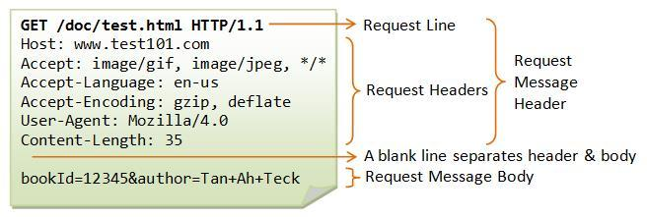

Slide 8
Client
HTTP Request
Server
IP Address:
12.564.55.44
HTTP Response
IP Address:
344.187.86.25

Slide 9


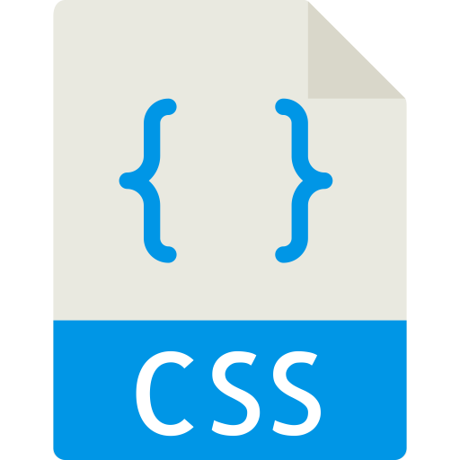

HTTP Response
101100101000
File
(Download)
Web Page

Slide 10
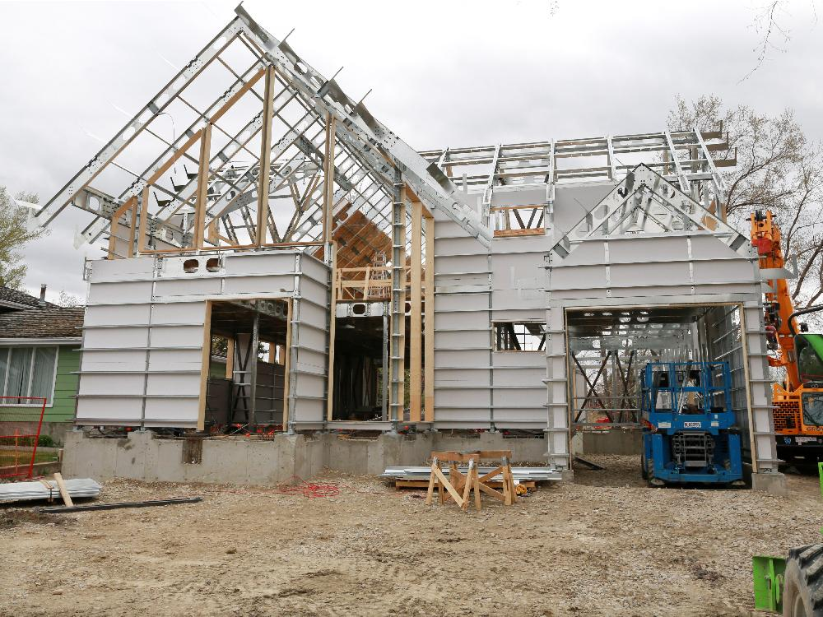
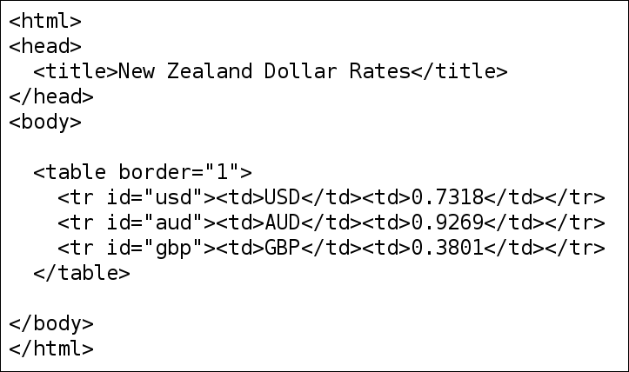

Slide 11

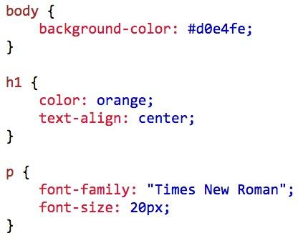

Slide 12
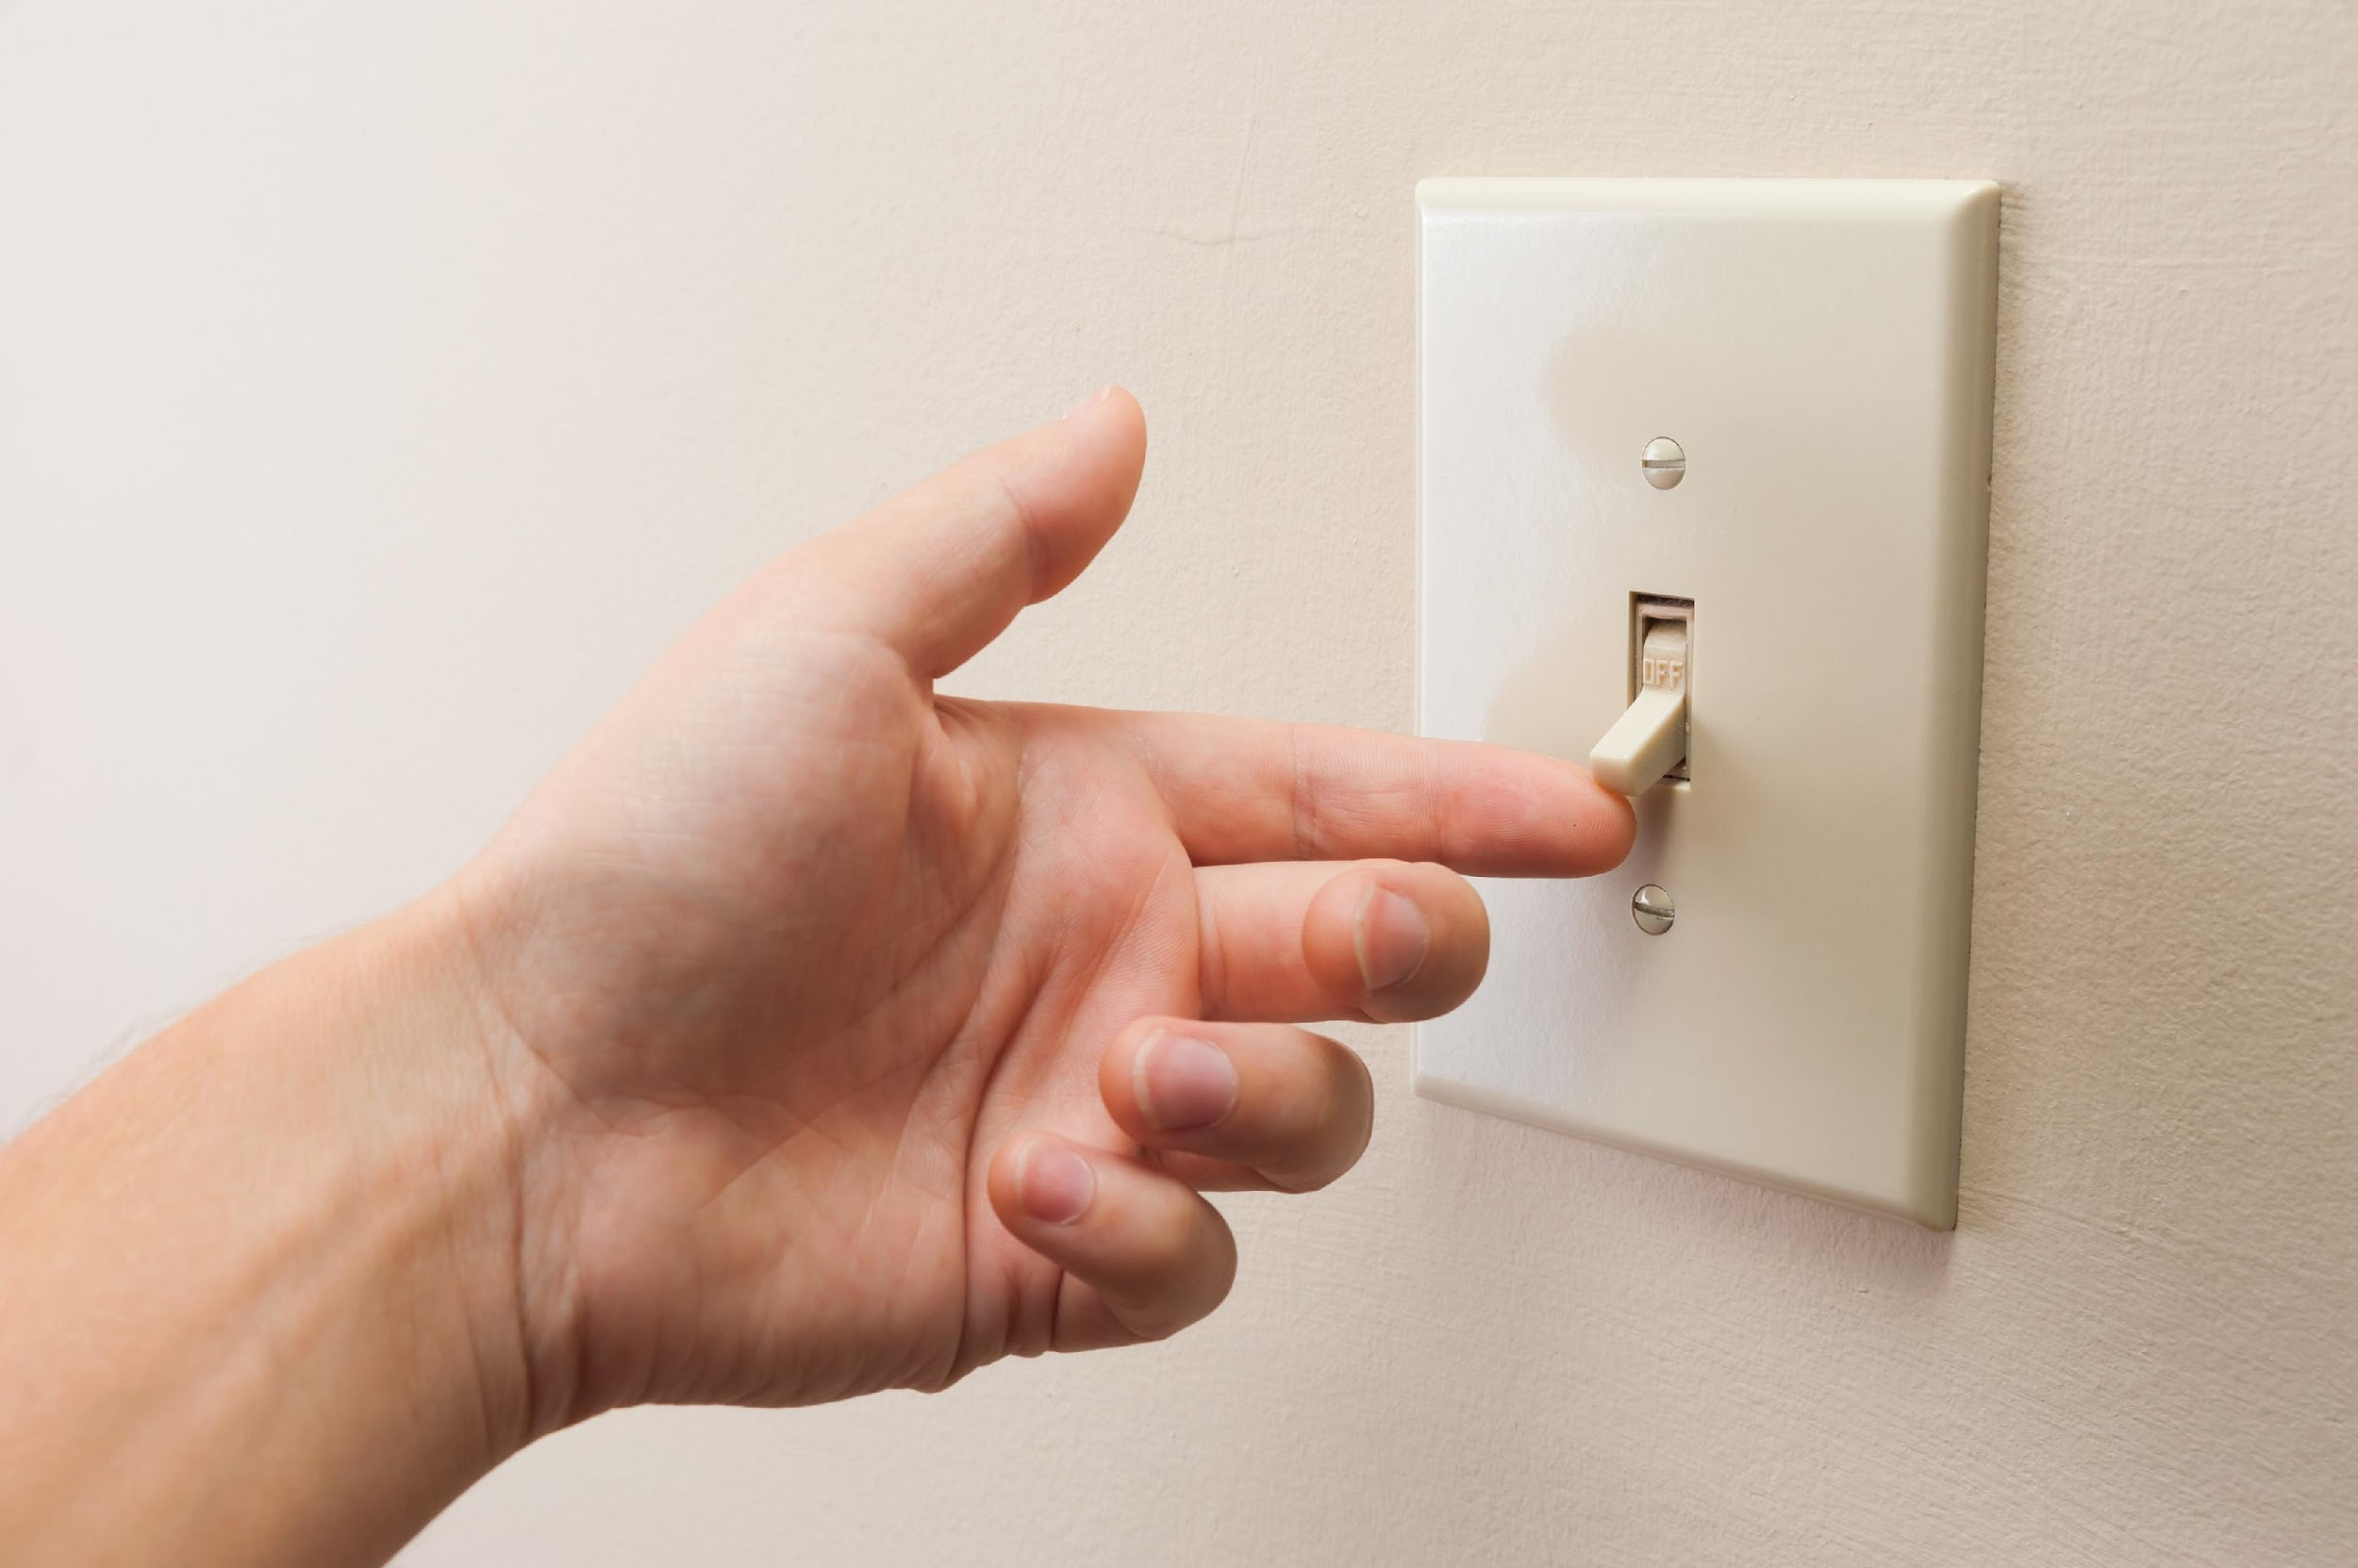

Slide 13



Slide 14
ASP .NET
DATABASE?
Server?
Python
C#
PHP?

Slide 15



Client
Server

Slide 16
Technical

Slide 17

High-level, Dynamic, Interpreted, Untyped
Programming Language

Slide 18
Syntax
(n). the arrangement of words and phrases to create well-formed sentences in a language.

Slide 19
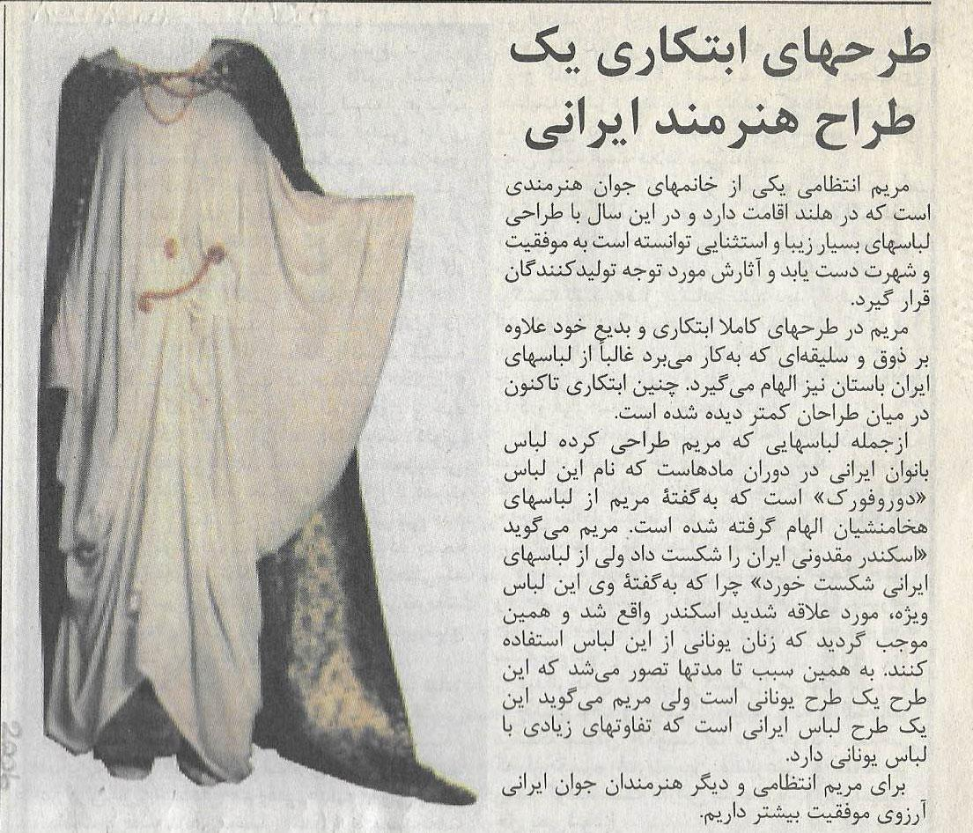
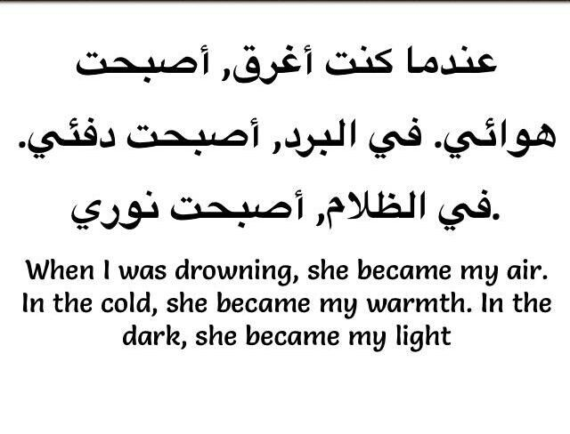

Slide 20
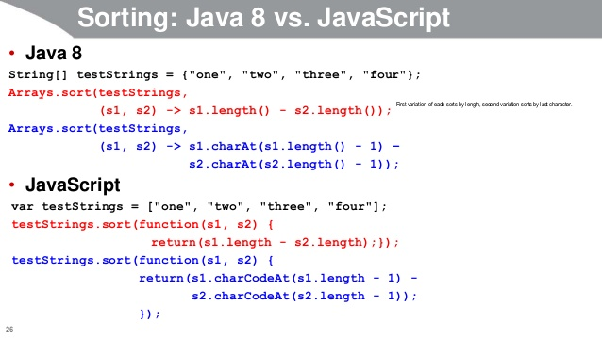

Slide 21
…101001010
1000101100
1000101010
001101001…
…00101010
101010010
001010100
010110…
CPU

Slide 22
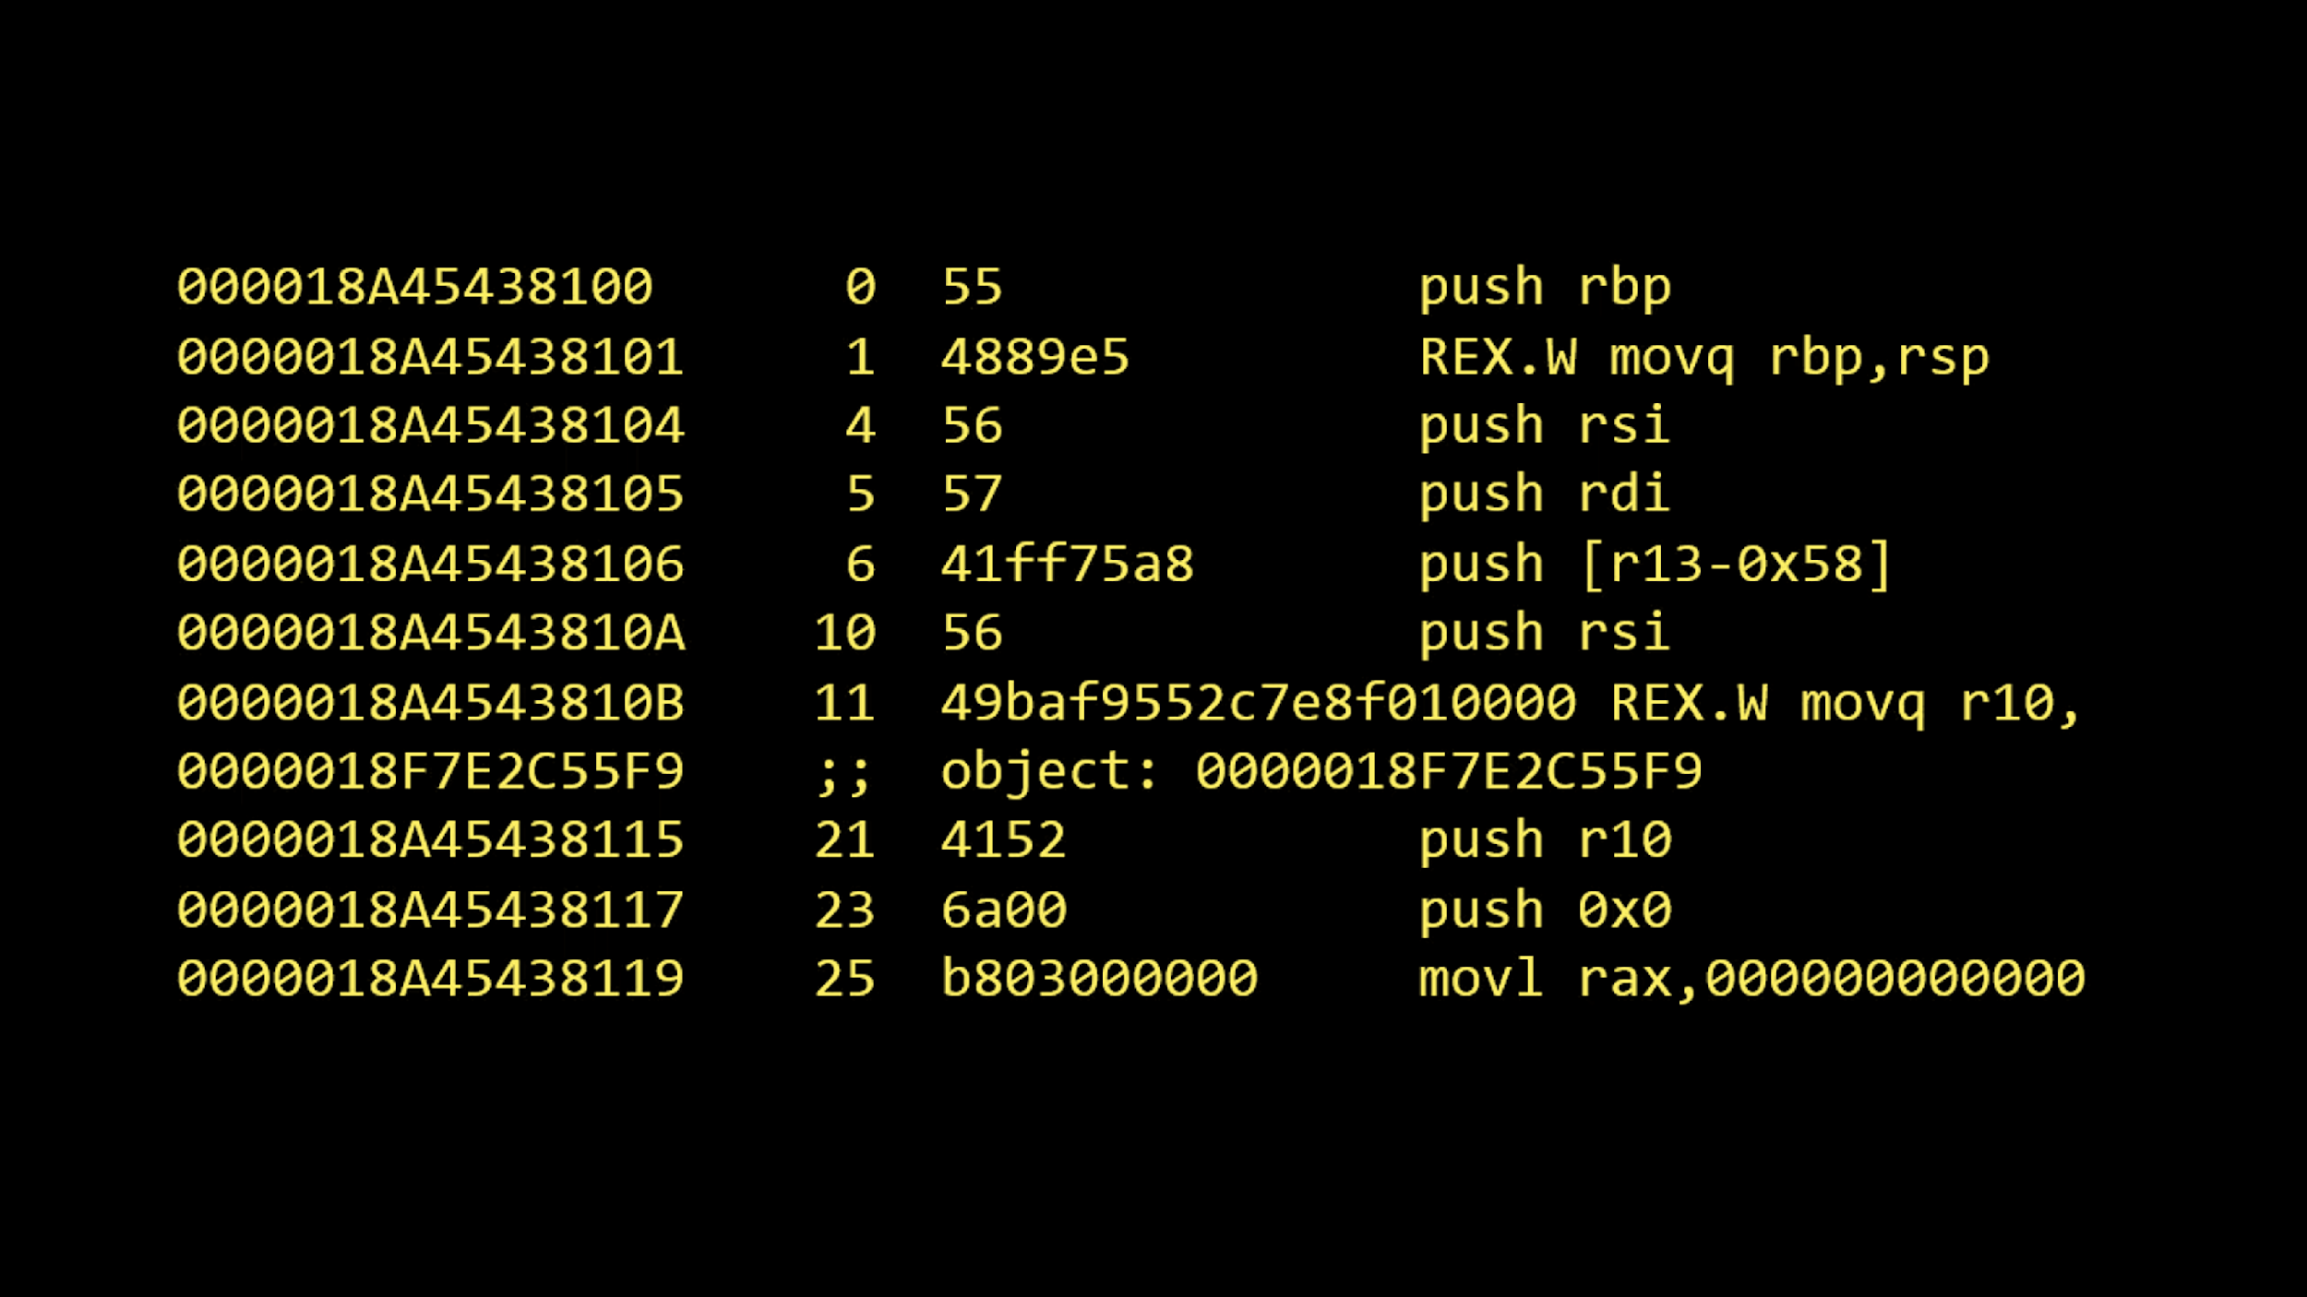

Slide 23
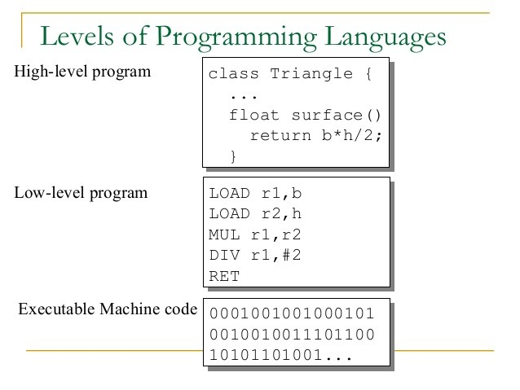

Slide 24
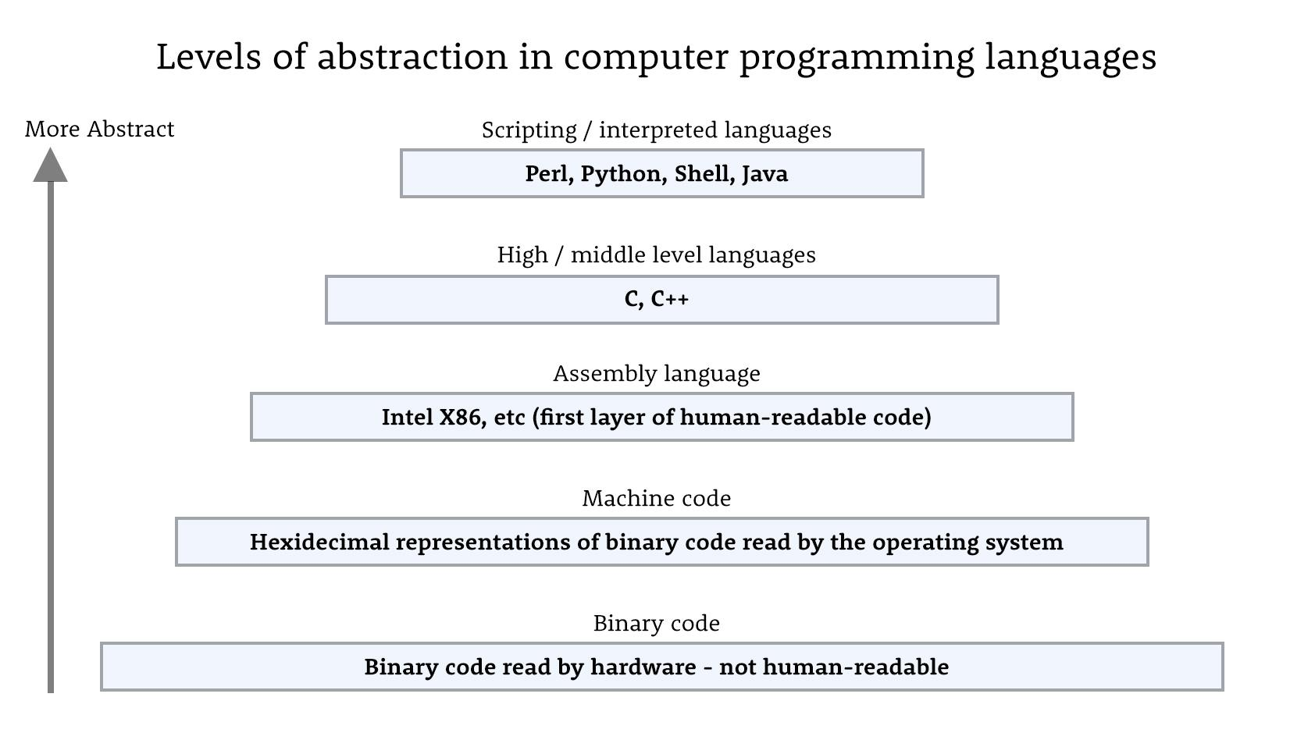

Slide 25
Run time
VS
Compile-time

Slide 26
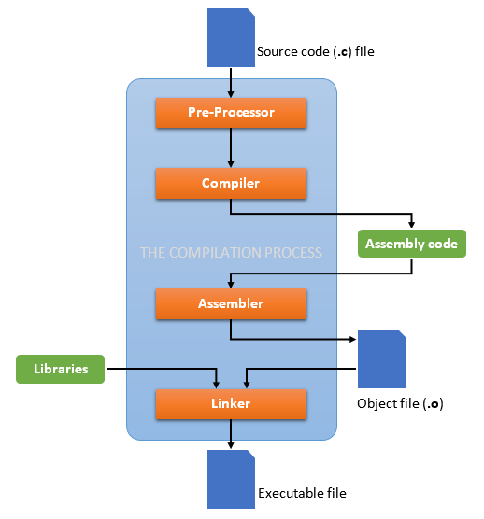

Slide 27
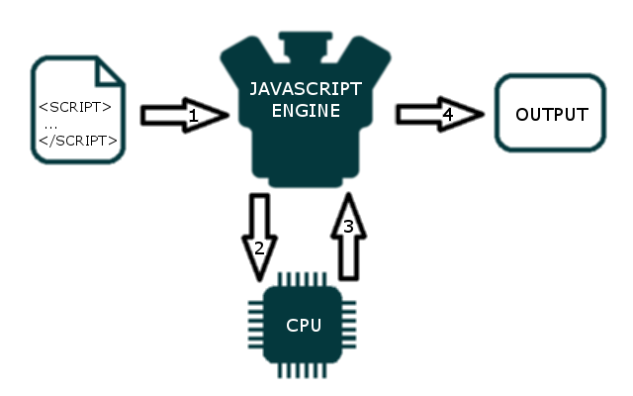
Runtime Environment

Slide 28
Dynamic Programming Language
(And Untyped)
var x = 10;
var text = “hello world;
x = “Hello Again”;
Int x = 10;
String text = “hello world”;

Slide 29

Interpreted
Vs
Compiled
CMD in windows
Bash for Unix-based OS
Visual Basic
Python

Slide 30
Browsers
DOM Interpreter
3 JIT Compilers
CSS Interpreter
JavaScript Engine

Slide 31



JavaScript Engine
V8
Spider Monkey
Nitro
Chkara

Slide 32
ECMAScript
JAVA? Script

Slide 33
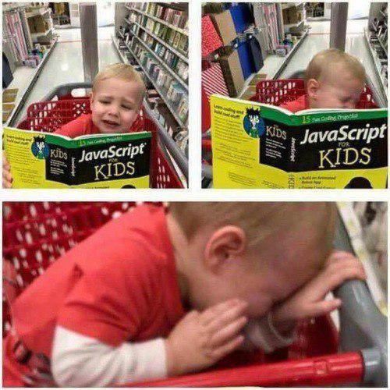

Slide 34


Slide 35
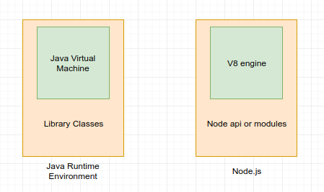

Slide 36
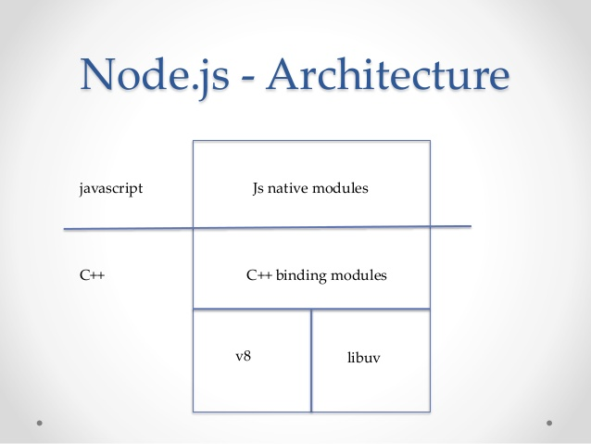

Slide 37
